Slide 1
RAILWAY SIGNALLING & CONTROL
Presented by:
PULKIT KUSHWAHA
B.C.E.3RD YEAR
001510401130
GUIDED BY:
PROF.(DR.)PRITAM AITCH
CIVIL ENGINEERING DEPARTMENT
JADAVPUR UNIVERSITY

Slide 2
INDIAN SENARIO
Founded in 16th april,1853(about 161 years ago).
Head quarter is in new Delhi, India.
Revenue is 1441.67 billion inc (2014-2015).
Profit is 157.8 billion inc (2014-2015).
About 1.307 million employees (2015).
There are 17 railway zones.
It is the world's Fourth largest railway networks comprising 115,000 km of track over a route of 65,436 km and 7,172 stations.

Slide 3
Objectives of Signalling
To regulate the movement of trains so that they run safely at maximum Permissible speeds.
To regulate the arrival and departure of trains from the station yard.
To ensure the safety of two or more trains that have to cross or approach each other.
To ensure the safety of the train when it comes in contact with road traffic at level crossings.
To provide facilities for safe and efficient shunting.
To guide the trains to run at restricted speeds during the maintenance and repair of tracks.
To maintain a safe distance between trains that are running on the same line in the same direction.

Slide 4
CLASSIFICATION OF SIGNALLING
SIGNAL
Visible
Audible (detonators)
Hand signals
Fixed signals
Caution indicators
Stop signals
Coloured light (two, three, or four aspects)
Semaphore signals Lower quadrants (two aspects) Modified lower quadrants (three aspects) Upper quadrants (three aspects)
Distant, home, starter, advanced starter, calling-on shunt repeater, automatic
Warner, outer, home starter, advanced starter, calling-on, Shunt, repeater, coaching

Slide 5
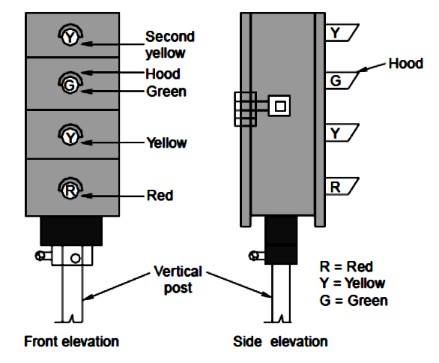
COLOUR LIGHT SIGNALS
Two-aspect, namely, green and red
Three-aspect, namely, green, yellow, and red
Four-aspect, namely, green, yellow (twice), and red.
In India, mostly three-aspect or four-aspect coloured light signalling is used. In the case of three-aspect signalling, green, yellow, and red lights are used. Green indicates ‘proceed’, yellow indicates ‘proceed with caution’, and red indicates ‘stop’.
Fig.1 Coloured light signal

Slide 6
SEMAPHORE SIGNALLING
Semaphore signals are rectangular or fish tailed arm fixed to a vertical Post.
The arm is rotated in different angles to convey information to the Loco driver.
Fig.2 Semaphore signal

Slide 7
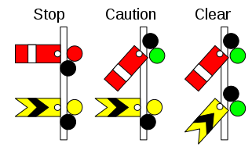
SEMAPHORE AND WARNER SIGNAL
Semaphore and Warner signals can be placed on same the pole .
Semaphore is placed on top and the Warner at about 2m below it
Fig.3 Semaphore and Warner signal

Slide 8
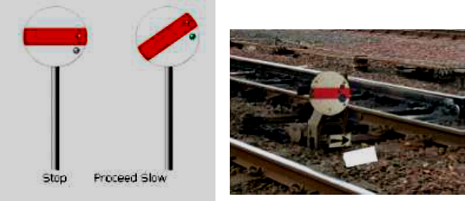
DISC OR SHUNT SIGNAL
These are shunting signals which are used for low speed movement during shunting operations. They consists of circular discs with red bands on white background
Fig.4 Disc or Shunt signal
When Red band is Horizontal: Stop
When Red band is Inclined: Proceed

Slide 9
ADVANCED SIGNALLING SYSTEM
Block Proving Axle Counter Automatic verification of complete arrival of train
Adoption of Proven Train Protection Proven train protection technology like TPWS/ETCS on HDN routes and automatic signalling territories
The Automatic Block System It consists of a series of signals that divide a railway line into a series of sections, or "blocks". The system controls the movement of trains between the blocks using automatic signals.
Train Collision Avoidance System Prevention as well as protection against Signal Passing At Danger (SPAD) by loco pilot

Slide 10
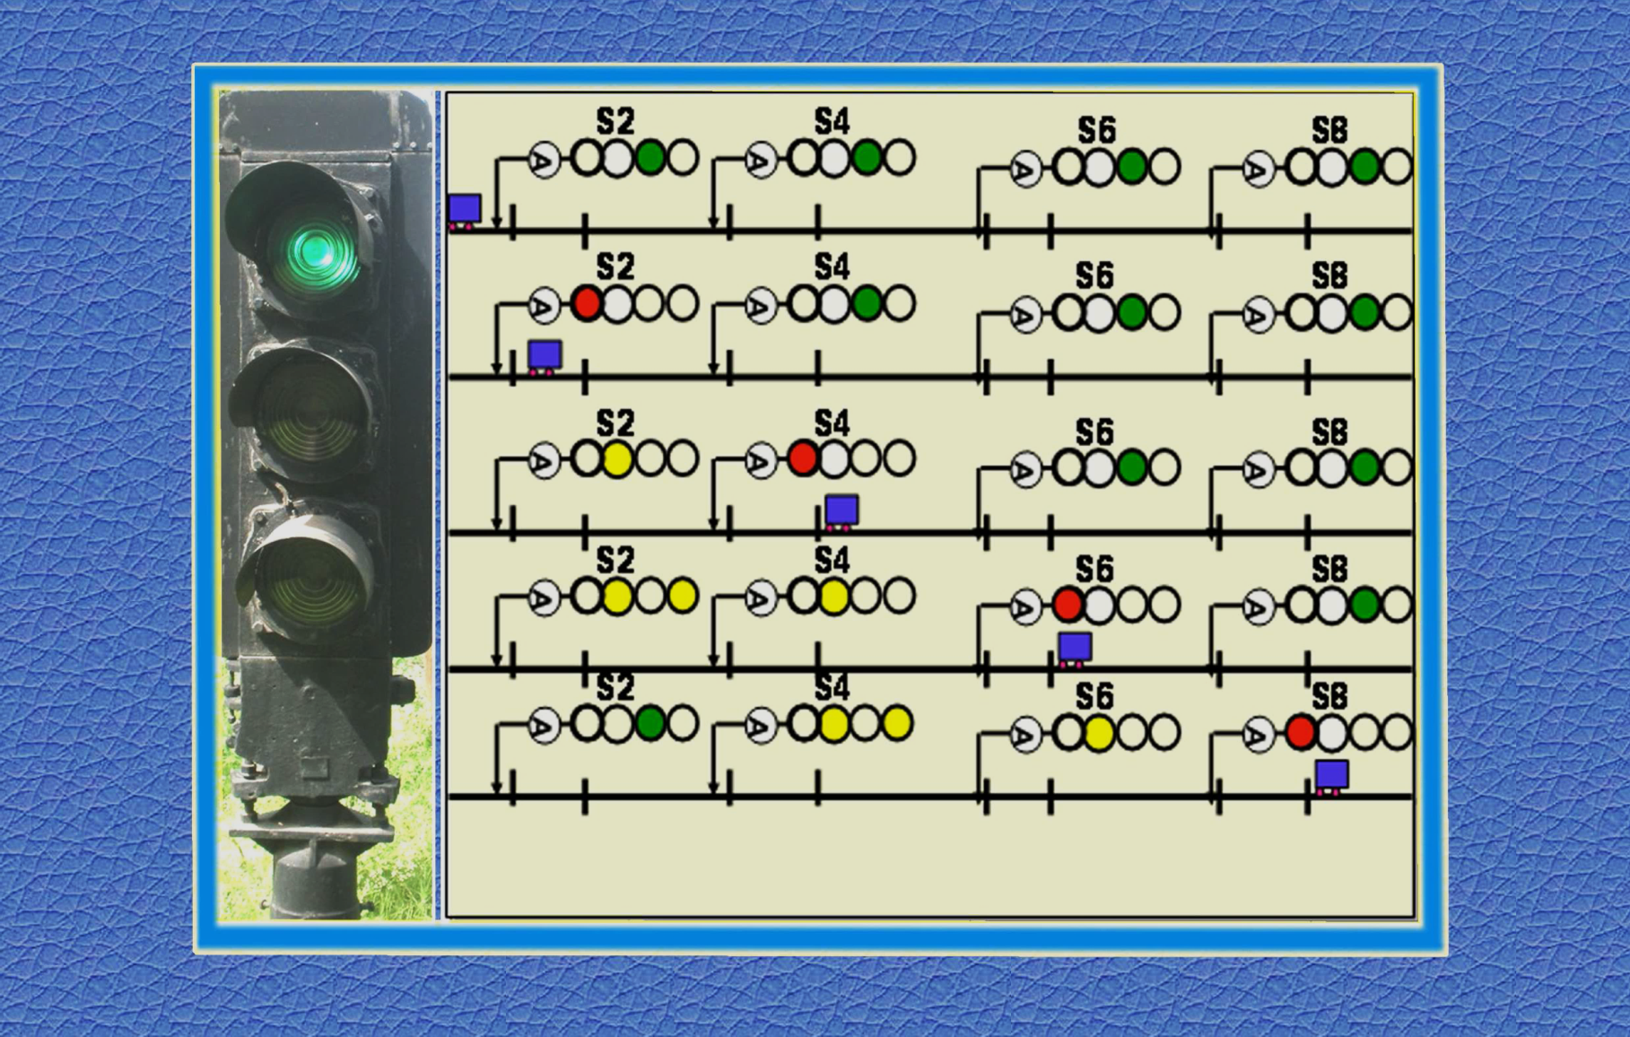
Automatic Block System
Fig.5 Three aspect signalling territory
Fig.6 Four aspect signalling territory

Slide 11
RAILWAY CONTROL

Slide 12
TYPES OF CONTROL SYSTEM
Section Control/Train Control
Deputy Control
Traction Control
Signalling & Telecommunication Control
Emergency Control
Emergency Wireless Control Communication

Slide 13
CONCLUSION
To safety receive and dispatch trains at station
To control the movements of trains from one station to another after ensuring that the track on which this train will move to reach the next station is free from movement of another train either in the same or opposite direction. This Control is called block working.
Preventing the movement from opposite direction is necessary in single line track as movements in both directions will be on the same track

Slide 14
REFERENCES
ADVANCE SIGNALLING SYSTEM AND RAILWAY TELECOMUNICATION CONTROL Page(1-6) http://www.sr.indianrailways.gov.in/cris/uploads/files/1458888464879-rti-%20signal.pdf
CHAP 1 – Introduction, CHAP 2 - Some Basic Specs ,CHAP 3 - Glossary of Signal Terminology-www.railroadsignals.us/basics/basics1.htm
Contents-Signalling systems, Semaphore signals, Colour-light signals, Signal indications, Miscellaneous information on signals- www.irfca.org/faq/faq-signal.html
DETAIL EXPLANATION OF RAILWAY SIGNALLING Page(1-30) http://www.indianrailways.gov.in/railwayboard/uploads/directorate/safety/SR_SR/SR_SR_CHAP3.pdf
PRACTICAL RAILWAY ENGINEERING by Clifford F Bonnett-1996 edition by Imperial College Press, London, Page(147-166) https://drive.google.com/file/d/1q-uRwYoYZCP1Dc7K70HwqnFE-8Y7jGWM/view
RAILWAY CONTROL Page(1-2) https://drive.google.com/open?id=0B1nKmQlcH_EPUjZXRlZvc0hYZnF0cGFjTHZnY0p1VnVSaExB
Railway Engineering by Satish Chandra & M.M. Agarwal, 2007 edition by Oxford University Press, Page(537-551) https://drive.google.com/file/d/113L7WHW-Ez8VEvGTQob20o_5K7QT_luz/view

Slide 15
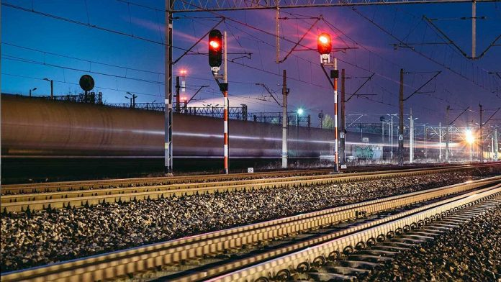
THANK YOU

